Slide 1

STARTUP COMPANIES PROFIT ANALYSIS

Slide 2

OBJECTIVE
The objective of the Profit Prediction for Startup companies is to build a machine learning model that can predict the profit based on its spending in various areas. This model will provide valuable insights into how different factors such as R&D spending, administration spending, marketing spending, and location influence a startup's profitability.

Slide 3
SUMMARY
I have been tasked to build an ML model that can predict profits. My goal was to explore what type of data was available and shape them to fit into the success-proven model which makes the profit analysis accurate. Moreover, the task involves building a linear regression model to predict profits for 50 startups using a pre-defined dataset.
My analysis of the 50 start-up companies’ profit is achieved by gathering data and utilizing descriptive statistics and visualizations has shown how the data is distributed in different categories. we are training the module for prediction, and with the help of Exploratory data analysis, we are plotting
and showing graphs and data in visual form. Making a more accurate model than the previous one is our main objective.

Slide 4
PROPOSED METHODOLOGY
Data Gathering: - This is the first step involved in the process of making profit prediction.
Selecting a Model: - Multiple Linear Regression is the machine learning algorithms implemented in this model to predict the profit. Multiple Linear Regression is usually used when there is a continuous dependent variable and two or greater than two independent variables. Similarly, for this model we have profit as a dependent variable and rest other parameters Marketing Spend, Administration Spend and R&D Spend as the independent variables.
Prediction of Profit: - One of the above-mentioned models can be used to make prediction of profit by providing the values of the required variables. These parameters include money spent for different causes such as R&D, Marketing and Administration purpose.

Slide 5

DATA PREPROCESSING:
Data Pre-processing is done after loading the dataset. This step involves optimizing the dataset by removing the outliers and unnecessary details from the dataset to provide most accurate results. Since location does not has any continuous relationship with the value of profit therefore the location column has been dropped from the dataset for further steps. The entire dataset is split in the ratio of 3:7 for testing and training the model respectively

Slide 6
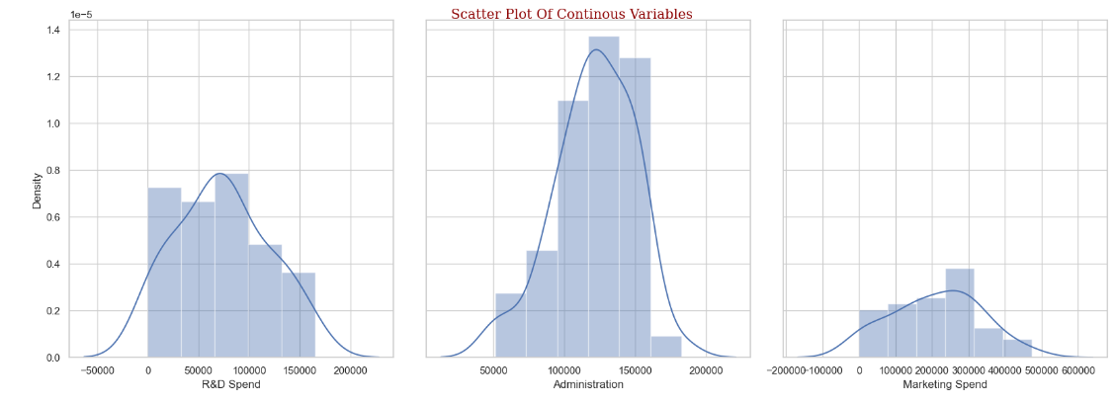
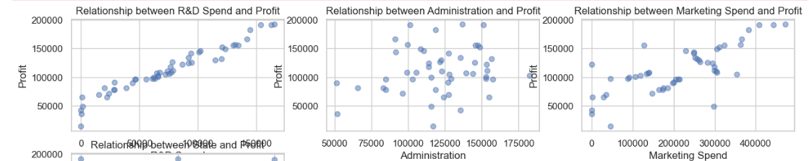
Data distribution check
Scatter plot of continouse variables
Linearity check

Slide 7
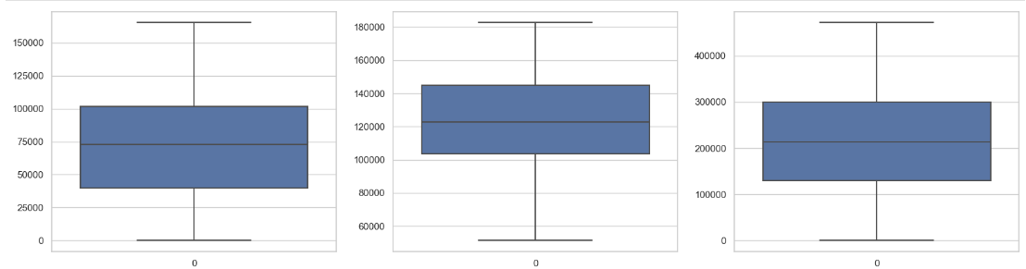
BOX PLOT to find outliers in the numerical features

Slide 8
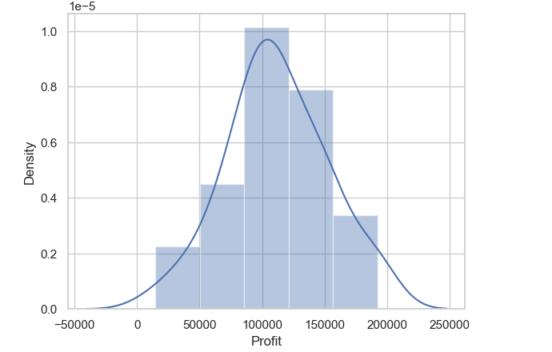
Understanding the overall distribution of a data

Slide 9
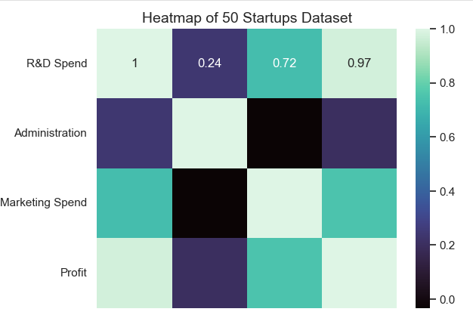
HEATMAP to explore the correlation b/w numerical feature

Slide 10
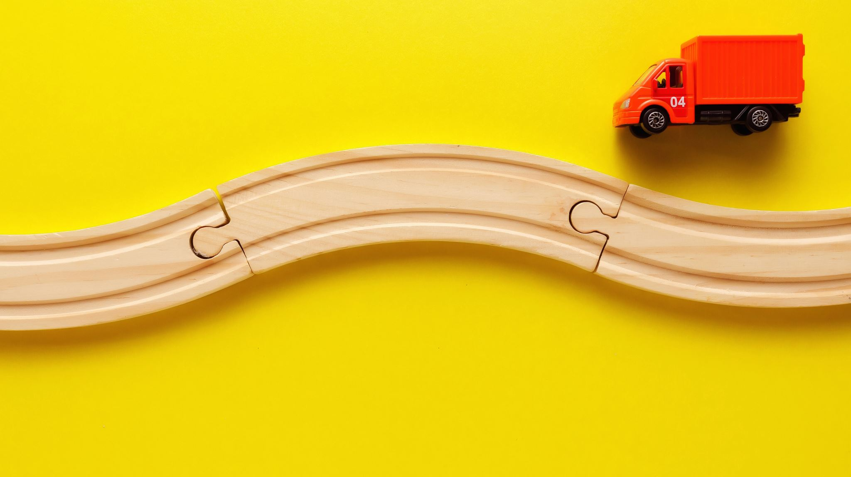
TRAIN AND TEST THE MODEL
Here assisting values in x and y for feature selection
X=independent variables = r&d spend, admin, marketing spend, state
Y=dependent variable =profit
Treat categorical data with the dummies by using dummy variable trap
Now splitting the test data for training and testing basis with 2:8 ratio

Slide 11
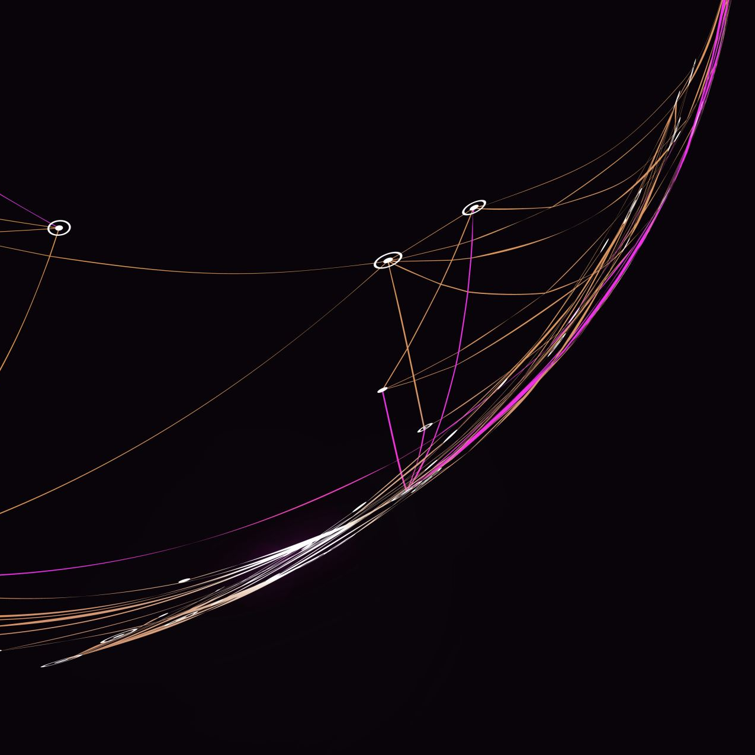
MODEL DEVELOPMENT
As per the EDA done earlier our data form a gaussian distribution which is linearly seperable and also good fit for linear regression.
When the model is ready we can check the prediction
Can also see the difference between actual and prediction y

Slide 12
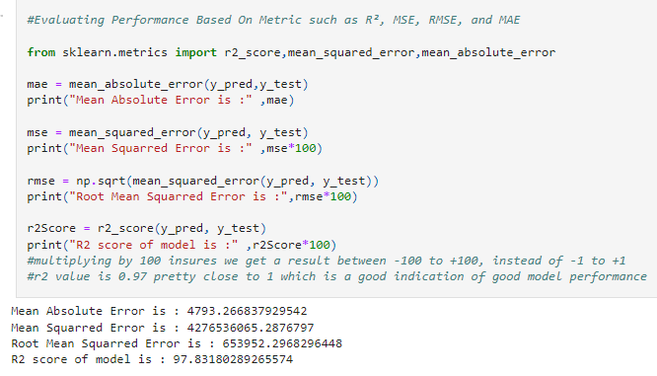
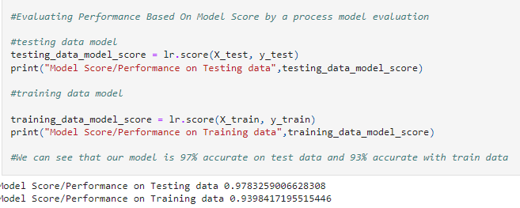
MODEL EVALVATION
Process model evalvation
Metric based evalvation

Slide 13
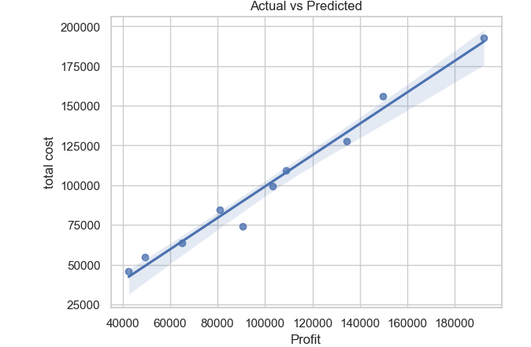
Linear line for actual and predicted values

Slide 14

CONCLUSION
The profit prediction model can provide an overview to the people willing to set up a startup or are already running a startup about the value of profit that could be achieved based on the values of money spent on different factors. This model will help decide the money distribution for the enhancement of profit. This model efficiently analyses the trends and the values of the different parameters present in the dataset to predict the profit more accurately. Building a profit prediction model helps an investor in various ways such as saving time and providing an accuracy

Slide 15


